Slide 1

THREAT INTELLIGENCE SYSTEM
Amanuel Bekele, Tyler Mullins, Julius Niyonzima, Ibrahim Alborno, Steven Tran
CyberShield

Slide 2


INTRODUCTION & PROJECT OBJECTIVES
Our platform addresses the growing cybersecurity challenges facing online retailers by providing real-time threat intelligence and automated risk management.
The primary objectives were to: integrate real-time OSINT data, develop AI-powered risk scoring, implement automated threat hunting, and create proactive defense capabilities.
This 9-week project demonstrates how modern AI and automation can transform cybersecurity operations for e-commerce platforms.

Slide 3


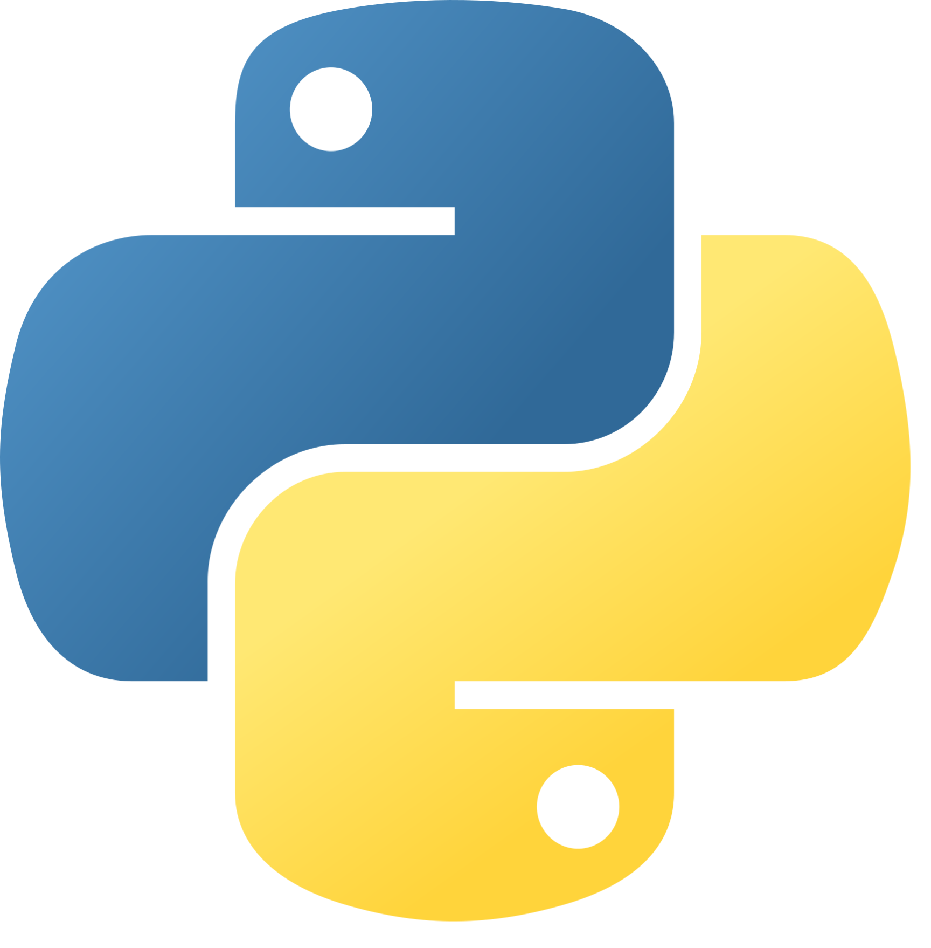




TECH STACK
Front End
Back End
DevOps
Database
GitHub
AWS
DigitalOcean
React
MUI
PostgreSQL
DigitalOcean
Python

Slide 4

LIVE SYSTEM DEMO

Slide 5
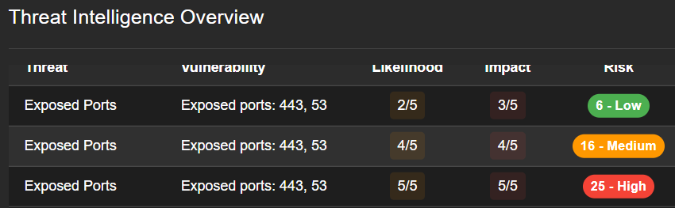
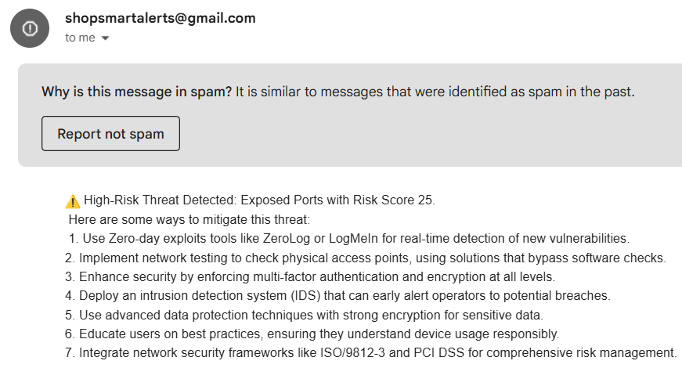
SECURITY FEATURES & RISK MANAGEMENT APPROACH
Our Software notifies the ShopSmartSolutions team the level of the risk that they are experiencing (Low, Medium, High)
The ShopSmartSolutions team is sent an email, from shopsmartalerts@gmail.com, which contains information about the threat and what they can do to mitigate it

Slide 6
TESTING & EVALUATION METRICS
Vulnerability Detection: Measures how effectively your CyberShield tool identifies the high and medium-risk vulnerabilities that were found in the scans.
XSS Protection: Addresses the reflected cross-site scripting vulnerability that was rated as high severity in both Burp Suite and ZAP scans.
Cookie Security: Focuses on the missing secure cookie attributes that could leave sessions vulnerable to interception.
CSRF Mitigation: Targets the cross-site request forgery vulnerabilities found in login and registration endpoints.
Server Exposure: Covers the server version disclosure risk that could allow attackers to exploit known vulnerabilities.

Slide 7
CHALLENGES & SOLUTIONS
Hosting the database on DigitalOcean
Deploy the website
Getting email notifications to work
Implementing AI into our system
Researched how to properly host it and got it to work
Paid for AWS instead of using free options
Environment variables were incorrect
OpenAI wasn’t working so used DeepSeek

Slide 8
FUTURE IMPROVEMENTS
NOW
OSINT Integration
Real-Time Threat Dashboard
AI-Powered Risk Scoring
TVA Mapping System
Automated Alert System
Development
Database
Testing
Additional OSINT Source Integration
Advanced Trend Analysis
Continuous Security Validation

Slide 9
THANK YOU!

